Slide 1
Recommendation System for TED Talks
TED Talks are popular video presentations covering a wide range of topics, including technology, entertainment, design, science, and business. With thousands of talks available on the TED website, finding the right one to watch can be challenging. A recommendation system can help users find talks that match their interests and preferences. This project proposes the development of a machine learning-based recommendation system for TED Talks.

Slide 2
Objective: The primary objective of this project is to develop a recommendation system that can recommend TED Talks to users based on their viewing history, preferences, and ratings. The system will use Recommendation algorithms to learn from user interactions and make personalized recommendations.
About Data: The transcripts of all the audio and video recordings of Ted talks posted on Ted.com make up the dataset I'll be utilizing to build a recommendation engine for Ted Talks in this article.
Data Link: https://www.kaggle.com/datasets/rounakbanik/ted-talks?select=ted_main.csv
There are two CSV files.
ted_main.csv - Contains data on actual TED Talk metadata and TED Talk speakers.
transcripts.csv - Contains transcript and URL information for TED Talks

Slide 3
We have used 4 Recommendation Engines which are highly used for Various Recommendations.
Clustering
Colaborative Filtering
Content-Based Filtering
Matrix Factorization
Is a technique that uses the past behavior of users and the behavior of similar users to make recommendations
Is a technique that makes recommendations based on the attributes of the items being recommended.
Is a technique that decomposes a large matrix into two smaller matrices that can be used to make recommendations.
Is a technique that groups similar items together based on their attributes.

Slide 4
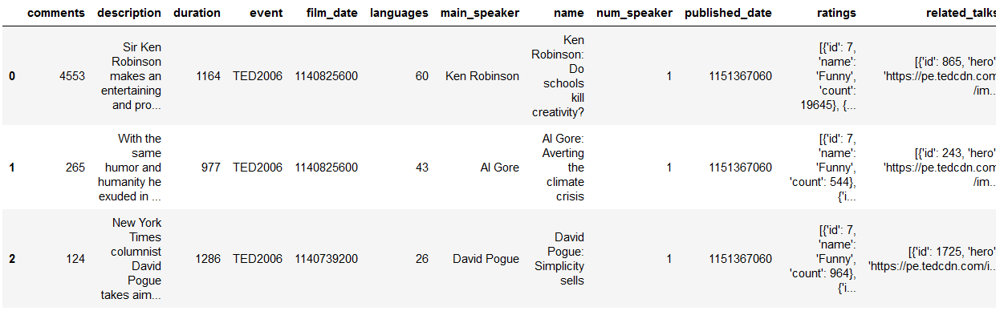
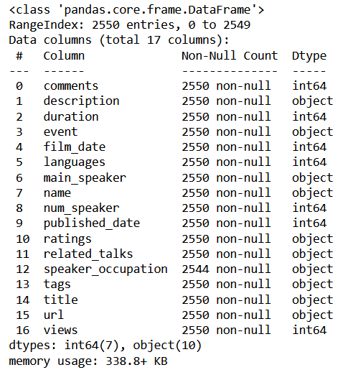
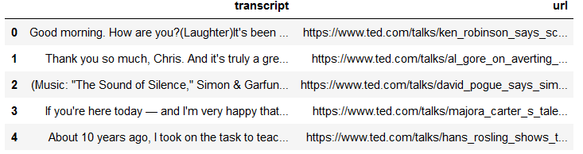
Visualizations
We can see the Glimpse of Data.
Dataset is a Mix of ID and Texts

Slide 5
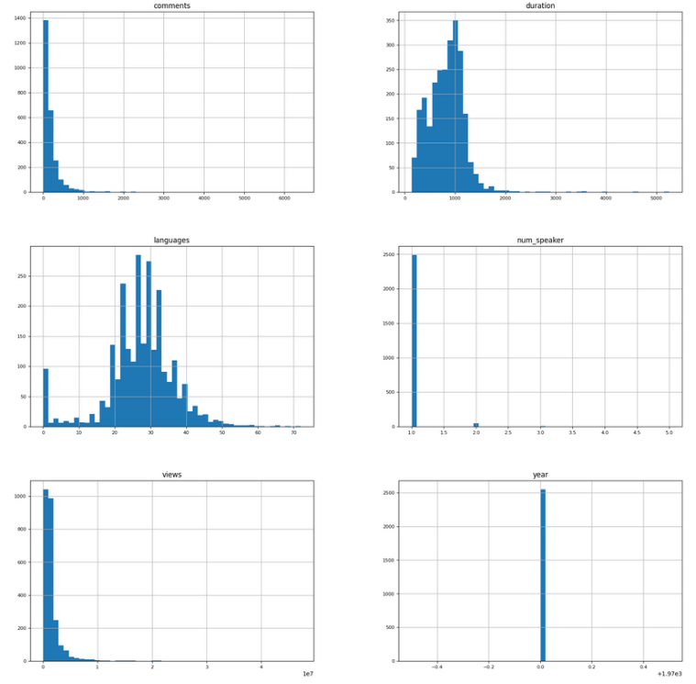
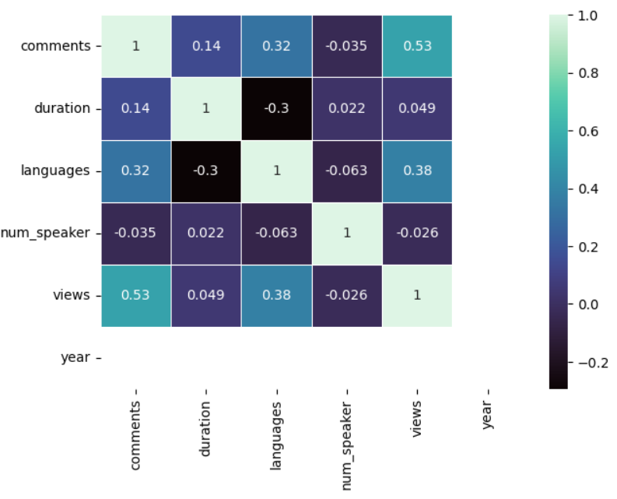
Histogram of Each Numerical Column in the data.
Correlation Matrix

Slide 6
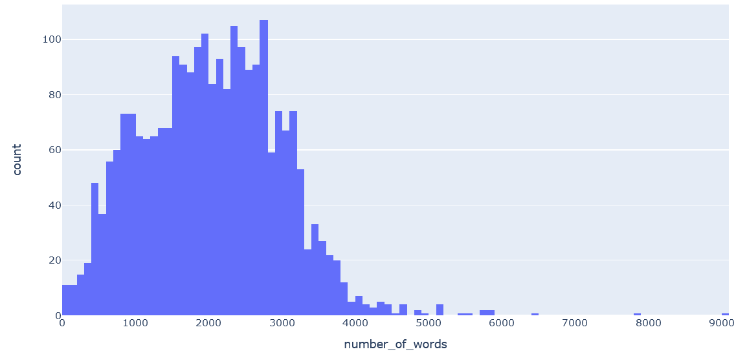
There are around 500 to 3000 words in a Ted Talk.

Slide 7
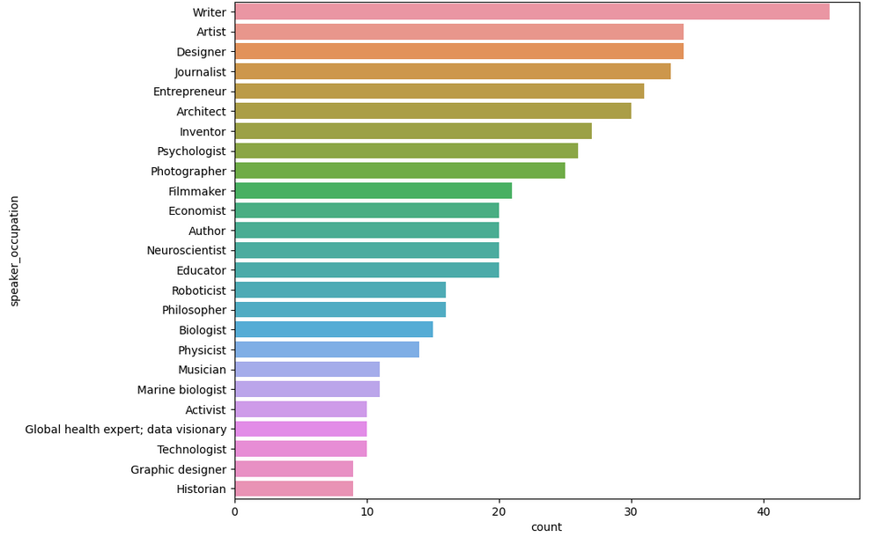
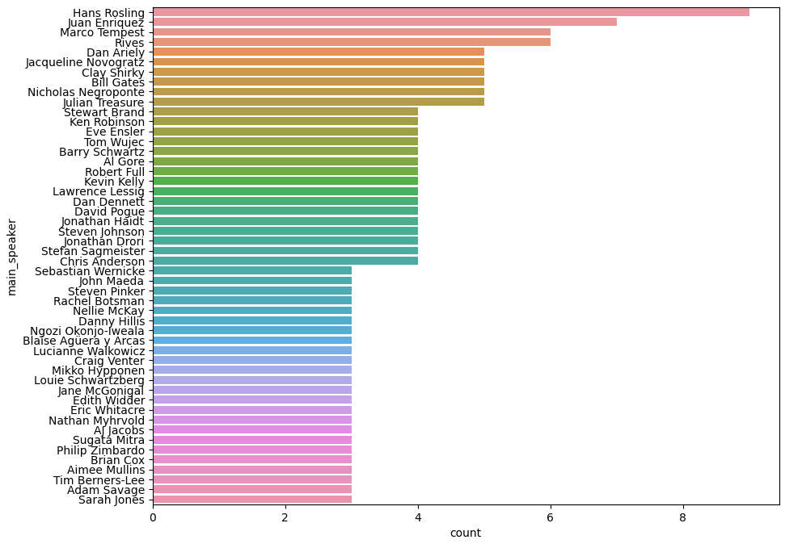
We can see that which speaker gave the highest number of talks.
In the below graph we can see that most of the speakers are from Artist or Writers background.

Slide 8
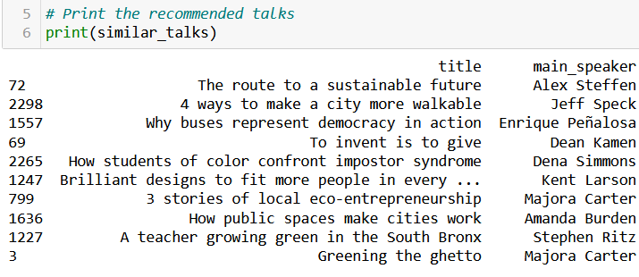
In this code we applied
Text preprocessing techniques such as tokenization, stop-word removal, stemming, and lemmatization to the transcripts of the Ted talks.
Then applies TF-IDF vectorization to convert the preprocessed text into a numerical representation. The TF-IDF matrix is then used to compute word embeddings using cosine similarity.
The code then applies K-means clustering with 5 clusters on the word embeddings.
To recommend talks, the code first searches for talks containing the search term
Clustering
Predictions

Slide 9
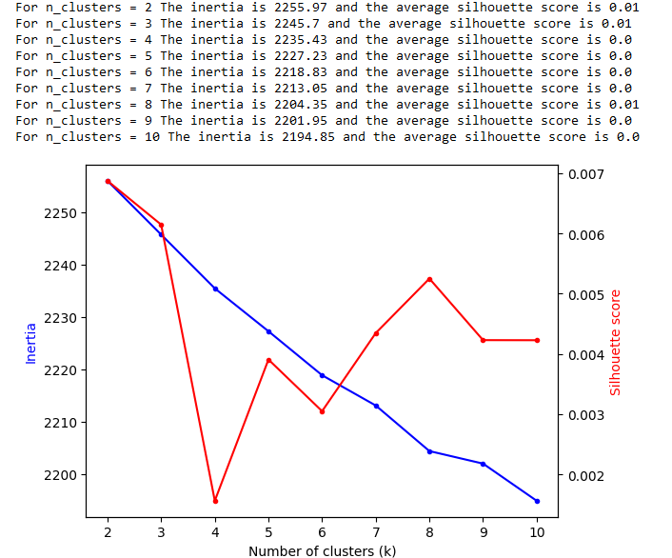
Evaluate the KMeans clustering model
We can see that the average silhouette score is positive which indicates that the model is a good model.
In the elbow curve we can see that the best number of K values for the cluster.

Slide 10
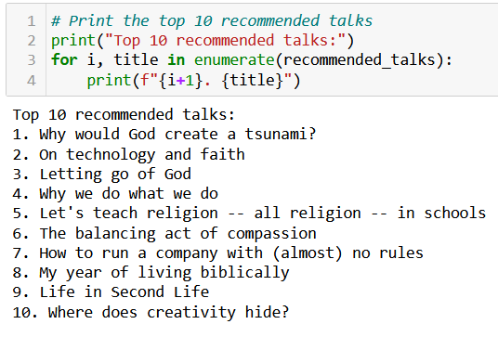
Collaborative Filtering
The process Performed the following text preprocessing techniques:
Tokenization: splits the text into individual words (tokens).
Stop-word removal: removes commonly occurring words that do not carry much meaning, such as "the", "a", "an", "in", etc.
Lemmatization: reduces words to their base form (e.g., "running" becomes "run").
TF-IDF Vectorization: converts the preprocessed text into numerical vectors using the Term Frequency-Inverse Document Frequency (TF-IDF) technique.

Slide 11
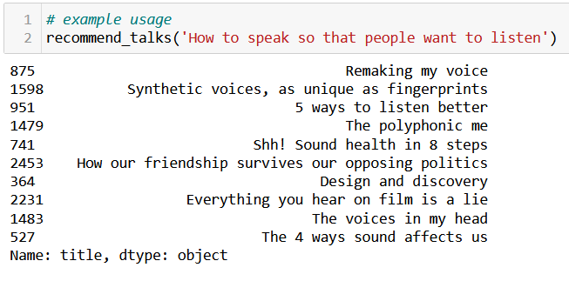
Content-Based Filtering
In the code, we first download the necessary NLTK data and libraries.
We then tokenize the text data using NLTK's word_tokenize() function
Next, we remove stop words using NLTK's stopwords corpus and perform stemming and lemmatization using NLTK's PorterStemmer and WordNetLemmatizer respectively.
After that, we perform POS tagging on the tokens using NLTK's pos_tag function and extract only nouns and adjectives from the POS tags.
Then, we convert the processed tokens back to text for vectorization using scikit-learn's TfidfVectorizer, which calculates the TF-IDF scores of the words in the text data.
Next, we calculate the cosine similarity matrix between all pairs of talks using scikit-learn's cosine_similarity.
Finally, we create a function recommend_talks that takes a talk title as input and returns the top 10 recommended talks based on the cosine similarity scores.

Slide 12
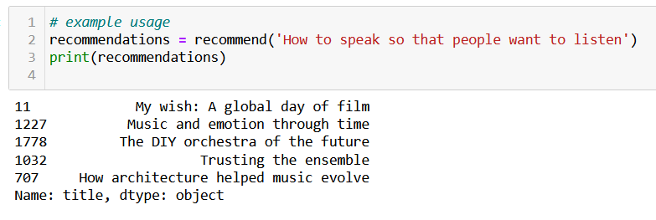
Matrix Factorization
The code performs
tokenization, stop-word removal, TF-IDF weighting, stemming, and lemmatization on the transcript text before calculating cosine similarities between talks.
The preprocess_text() function tokenizes the text, removes stop words, performs stemming and lemmatization, and joins the tokens back into a preprocessed string.
The TF-IDF matrix is then created from the preprocessed text using TfidfVectorizer(), and cosine similarities are calculated between talks based on this matrix.
The recommend() function takes a talk title as input, finds the index of that talk in the ted_data dataframe, calculates cosine similarities between that talk and all other talks, and returns the titles of the top 5 most similar talks based on cosine similarity.

Slide 13
TEDTalk data is often not used as frequently as movie data for recommendation systems. Although data can be scraped from the official TED website, the lack of actual recommendations within the data means that the process is often classified as unsupervised learning. Therefore, it may not be meaningful to evaluate the outcome using traditional evaluation metrics since there is no clear objective function to optimize. Nonetheless, researchers can still analyze and extract useful insights from the data through clustering and other unsupervised learning techniques.
Evaluation:

Slide 14
Conclusion:
The TED Talks dataset consists of a large number of talks, each with associated metadata such as the topic, speaker, and duration.
Matrix factorization an effectively captured the latent factors that influence a user's preferences and an item's characteristics.The matrix factorization algorithm could discover that a user is interested in talks about technology and entrepreneurship, and that certain TED Talks are focused on these topics, even if the user has not watched or rated those specific talks.
Matrix factorization is considered to be one of the most effective algorithms for recommendation systems, especially when dealing with large, sparse datasets with implicit feedback. Matrix factorization can capture the latent factors that influence the user's preferences and the item's characteristics, which can be used to make accurate personalized recommendations. Additionally, matrix factorization can be combined with other techniques, such as regularization, to prevent overfitting and improve the generalization of the model.
However, it is important to note that matrix factorization may not perform well for newer or less popular TED Talks, as these may not have enough data points to accurately capture their latent factors. In this case, Collaborative filtering or Content-based filtering could potentially be effective alternatives

Slide 15

Thank You

